Slide 1
This presentation is customizable. You and your teen might wish to work on this together, or your teen might wish to customize it themself. It can be used as an educational in-service for teachers and school personnel. You can also ask that a copy of this presentation be kept in your teen’s permanent file, in the nurse’s office, and in your teen’s classroom. One mother even asked that the teacher keep a copy in her folder for any substitute teachers.
Delete this slide before use at your school if you wish.
Anywhere you see [insert teen’s name – or other text in brackets] highlight the words and brackets and type in your teen’s name or pertinent information.
Insert photos of your teen throughout, or better yet, your teen may wish to insert their own photos. The more personal you can make this presentation, the more impact it has on school personnel.
Check the notes section for presentation notes and other tips for slides.
If you need assistance preparing this presentation, please contact us at info@hemophiliafed.org.

Slide 2
[Insert Bleeding Disorder], a Bleeding Disorder, and [Insert Teen’s Name]
At School

Slide 3
Meet [Insert Teen’s Name]
Age: [age] years old.
Siblings: [list names, ages, grade, or school names of siblings]
Bleeding disorder called [diagnosis].
Medication is for safety and wellness.
[Describe how medication is given. For example, a port, venous access, or orally.]
{Add photo of teen here}
Notes:
Customize this slide!!! Add a photo on the righthand side!
May want to mention medication schedule, other (non-bleeding-disorder) medications, or whether self-infusion is possible.

Slide 4
What is a bleeding disorder?
In order for our bodies to heal from injuries where blood vessels break (such as a bruise or cut), our blood must successfully clot*, which requires platelets and clotting factors. This process is called the clotting cascade.
Bleeding disorders are conditions in which there is a deficiency or malfunction of one or more of the factors (including platelets) necessary for proper blood clotting. Many bleeding disorders are hereditary.
*For an animation on how blood clots, please go to www.hfalearning.org and take the Clotting Cascade course in the Knowledge Park.

Slide 5
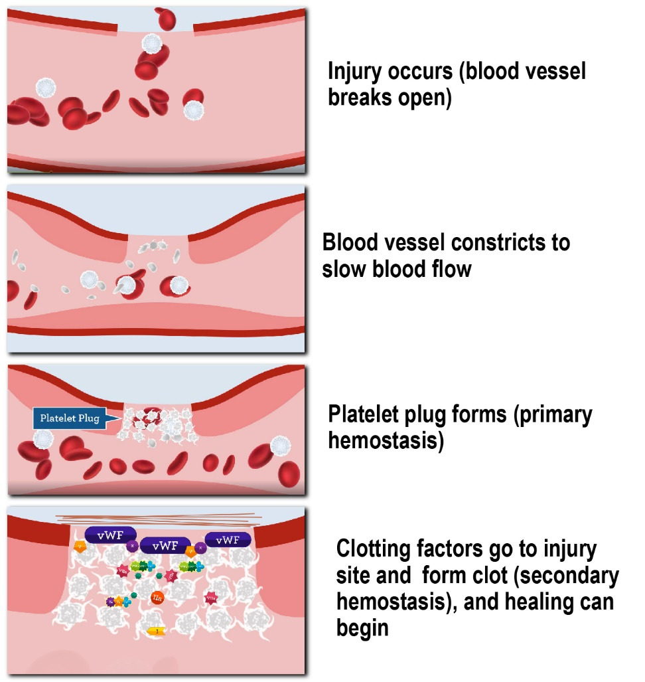
What Does That Mean?
Since those with bleeding disorders can’t clot properly, healing can take longer.
People with bleeding disorders like [insert diagnosis] bleed longer, not faster.

Slide 6
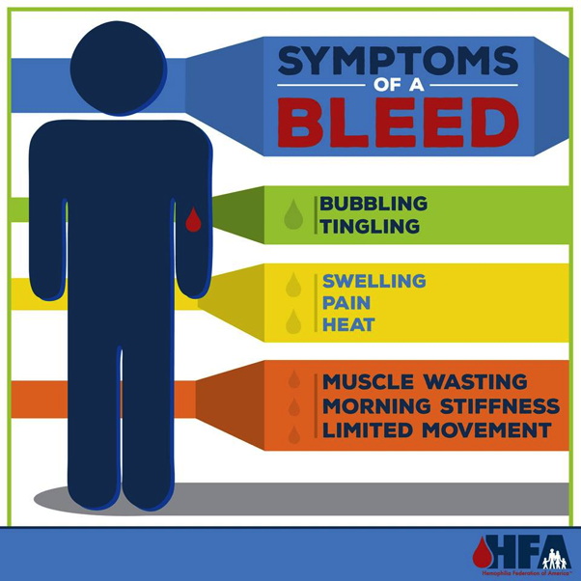
Bleeding Disorder Symptoms
Nose bleeds
Prolonged bleeding from cuts
Blood in the urine
Blood in stool (indicated by black stools)
Large bruises
Hematomas (lumps that usually happen after a bruise or a bleed)
Gum bleeds
Joint bleeds (watch for swelling/heat)
Muscle bleeds (watch for swelling/heat)
Heavy menstrual bleeding
*For more detailed information about bleeding disorder symptoms, please go to www.hfalearning.org and take the General Symptoms of Bleeding Disorders course in the Knowledge Park.
Notes:
Share with school personnel whichever of these symptoms are most common in your teen.

Slide 7
Types of Bleeds
Let’s talk about some common types of bleeds and what to watch for and do when they happen. We’ll be talking about the following types of bleeds:
Joint
Muscle/soft tissue
Heavy menstrual bleeding
Others: mouth, nose, scrapes, minor cuts
Notes:
Explain that you will discuss each of these kinds of bleeds in detail.

Slide 8
Joint Bleeding
Early signs of joint bleeding include bubbling, tingling and heat at the joint. (This is the best time to start treatment.)
Swelling and pain set in.
As the joint swells, it feels heavy or tight, and range of motion is limited
[teen’s name] may not be able to bear weight or move a limb.
Knees, ankles, and elbows are most often affected.
Watch for swelling, heat at the affected joint, and [teen’s name] favoring or being unable to use the joint.
WHAT TO DO: elevate the joint and apply ice and compression. Contact parent/guardian. If a plan is in place, provide treatment.
KEY POINT: [teen’s name] can feel a joint bleed LONG before anyone sees any outward symptoms.
[Insert a photo of teen here.]
Notes:
In the picture, point out the swelling, size and compare the right knee (which is bleeding) to left. But also mention that it’s best to treat a bleed as early as possible, which your teen can often identify before swelling is visible. The most common joint bleeds tend to be knees, ankles, and elbows, but a bleed can occur in any joint.

Slide 9
Muscle/Soft Tissue Bleeds
Signs and symptoms very similar to joint bleeding, but also can include tightness and/or shininess of skin
Usually happens in arms and legs but can happen anywhere in the body
Significant blood loss can happen quickly, and compartment syndrome is a risk
Leg, thigh, calf, forearm and groin most affected areas
Soft tissue bleeding is primarily characterized by bruising and hematomas (raised bruises)
Many teens with a bleeding disorder may have significant bruising all over their bodies
WHAT TO DO: Elevate the area if possible, apply ice and compression, and contact parent/guardian. If a plan is in place, provide treatment if warranted.
KEY POINT: [teen’s name] can feel a muscle or soft tissue bleed LONG before anyone sees any outward symptoms.
Notes:
Muscle bleeding is the second most frequent site of bleeding.
Any area of the body can be affected, but frequently, the extremities are involved. Large muscle bleeding can lead to nerve compression (e.g., iliopsoas, thigh - see picture). Significant blood loss can occur in large muscles before appreciable swelling is evident.
Bleeding into small muscles (e.g., in the forearm or calf) can also cause compartment syndrome.
Signs and symptoms of muscle bleeding may include:
Vague ache or pain
Heat
Swelling
Inability/unwillingness to move muscle
Tightness of skin
Shininess in skin

Slide 10
Heavy Menstrual Bleeding
Heavy menstrual bleeding can be very difficult to manage in a school setting
Heavy menstrual bleeding can lead to fatigue and possibly anemia
WHAT TO DO: If there is a request to use a bathroom, allow it immediately. Regular and immediate access to a bathroom, no questions asked (or only asked privately) will be necessary as the student may need access to a bathroom or a place to change clothes. Allow the student to bring extra clothing to school in case she needs to change. The student may feel unusually tired due to anemia and/or fatigue associated with their bleeding disorder.

Slide 11
Other Bleeding Episodes
Mouth bleeding
  May look worse than it is, as the blood is mixed with saliva
  Teen may vomit
  Feces or vomit may be black or dark brown (from swallowed blood)
Nose bleeding
  Sit up, pinch bridge of nose, cool pack on back of neck
  If longer than 20 minutes, call parents
Scrapes and/or minor cuts
  Wash, pressure, dressing
  Call parents if bleeding persists

Slide 12
Life-Threatening Bleeding
Call parents immediately if any of these bleeds occur.
Head/Intracranial
  Nausea, vomiting, headache, drowsiness, confusion, visual changes, loss of consciousness
Neck and Throat
  Pain, swelling, difficulty breathing/swallowing
Abdominal/GI
  Pain, tenderness, swelling, blood in the stools (black stools)
Iliopsoas Muscle
  Back pain, thigh tingling/numbness, decreased hip range of motion

Slide 13
Things to Expect
May be covered in excessive bruising
  Some older bruises may become lumpy or hard
May come to school “accessed”
  Needle inserted into his/her port
  Will be covered by tape and his/her clothing
May come to school wrapped in ACE bandage or Coban (self-sticking wrap)
May come to school with crutches or a wheelchair
Medication can be kept in nurse’s office, classroom, or with teen, depending on school policy
Notes:
Insert pictures on right hand side – maybe of your teen in some of these situations – ACE Bandage, with bruises, etc.
It’s possible he may miss school due to bleeding episodes. Agree to communicate with school to facilitate make up work, etc.
He may also come to school using assistive devices. It’s possible he could be in a wheelchair, on crutches, etc.

Slide 14
Bleeding at School
If a teen says she/he is having a bleed or is limping or not using an arm:
  Contact parents immediately
  Have the teen elevate the body part that is bleeding
  Apply ice to the area
Remember, the teen can feel a bleed before there are any outward signs
For superficial cuts or scrapes:
  Wash the area with an antiseptic soap
  Apply firm pressure
  Apply a dressing
  Contact parents if bleeding persists
Allow teen to treat or medicate by [insert treatment methods here] or according to their care plan

Slide 15
When to Call Parents
If [teen’s name] says something hurts and asks to contact parents
Injury to joints
ANY head or neck injury
Non-use or favoring of a limb
Swelling, warmth, or redness in a limb
Broken bone
Cut requiring sutures
Injury to torso (especially chest wall) or kidney area
Fever
Notes:
If your teen has a port, stress that it’s extremely important to call the parents immediately. A fever is a sign of a possible port infection which can be life threatening. Fevers must be thoroughly checked with blood culture to determine the cause of the fever.
Be sure to note: The parents will ask questions to determine how a bleeding episode started or how the injury occurred. Do not mistake this questioning as blaming – it’s only so the parents can help the medical providers determine the best course of treatment.

Slide 16
What Does This Mean in the School Setting?
All adults in contact with [teen’s name] should be aware that there is a teen with a bleeding disorder under their supervision
A care plan should be made with the medical staff, school personnel, and parents
  Parents will make sure this is in place with nurse
Key people should be made aware of the plan

Slide 17
Additional School Information
[teen’s name] should not be treated differently than any other student in the classroom
Leave it up to the parents and/or the teen to share with others that she/he has a bleeding disorder
There are no learning disabilities that are associated with bleeding disorders
Possible pain issues:
  Could have acute or chronic pain
  Could experience medication side effects

Slide 18
Activities
Unless having or recovering from a bleeding episode:
  Should participate in regular gym class
  Should go on all planned field trips
  Should play at recess with classmates
Some activities restrictions:
  Student’s doctor may say no contact sports
  May need immobilization during or after a bleed
  May need some alternative activities for inclusion in physical education, recess, etc.
Notes:
Can play along with other kids and do the same activities as others
Pay careful attention at recess & PE
No rough-housing with other kids
Does not have to wear helmet as of now
No jumping off equipment
Use equipment properly (no going up the slide, don’t come head first down slide, no jumping off play-sets, etc.)
Customize to your comfort level; items listed are only intended as examples from other parents.

Slide 19
Treatment Administration
For [teen’s name], [product name] is administered [how it is administered]
Treatment can be kept [insert where at school] and should accompany [teen’s name] if transported to the hospital
Treatment should be taken with student on field trips, in case of emergency.
Notes:
Use this slide to talk about how your teen is treated. Add pictures if you wish.

Slide 20
How Much Do Other Adults Need to Know?
If other parents ask about [teen’s name], they can be told:
  He/she has a medical condition
  He/she has [diagnosis]
  He/she has a bleeding disorder
Encourage them to talk to us if they have more questions. We welcome the opportunity to give them more information.
Notes:
You have to decide what’s right for your family in terms of disclosure to persons other than school personnel (other parents and students). If you or your teen are not comfortable disclosing to others, you can delete this slide.

Slide 21
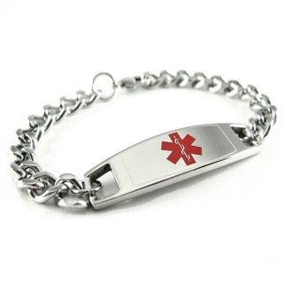
How Much Do Other Students Need to Know?
If other kids notice bruising, helmet, Medic-Alert bracelet, [teen’s name] can tell the other kids:
  “I have a bleeding disorder”
  “My blood doesn’t work right”
  “I’m missing something in my blood”
  “I don’t clot properly”
  “I get infusions”

Slide 22
Responsibilities
Student | Parent | School
Learn to communicate Tell someone when they are bleeding Do your schoolwork on time Make the same amount of effort as someone without a bleeding disorder | Communicate teen’s condition, activity level and treatment Help obtain makeup work Help the teen have a positive attitude about school Work with school staff and nurse to develop a medical plan | Monitor student achievement and inform parents of any change to personality, performance Communicate to parent/teen any observable sign of a bleed Stress the importance of completing assignments Promote ability and success, not inability Respect privacy and confidentiality

Slide 23
Summary
Please treat [teen’s name] like any other student
  Don’t label
  Don’t overprotect
  Don’t exclude
  Don’t overreact
Believe him/her if he/she says something hurts
CALL if you have any questions!
Notes:
Add any other concerns you have here

Slide 24
Conclusions
Remember that [teen’s name] is a normal teen who happens to have a bleeding disorder
If you have questions, call us ANY time!

Slide 25
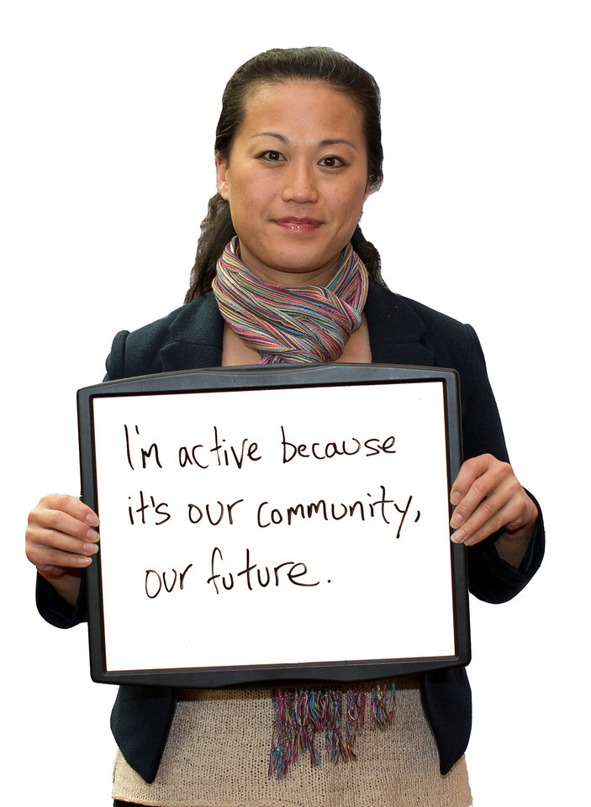


Like us
on Facebook
Keyword: Hemophilia Federation of America
Follow us
on Twitter
@hemophiliafed
Contact us:
  hfaprograms@hemophiliafed.org
  info@hemophiliafed.org

Slide 26
Backup slides
Pull any of these slides up into your main briefing to tailor it to your audience.

Slide 27
Treatment of Bleeding Episodes
Early and appropriate treatment of each bleeding episode is critical to minimize complications.
Treatment may vary depending on the type and severity of the disorder, as well as response to previous therapy and other medications the person may be taking
The recognition of bleeding episodes and treating bleeds as early as possible can help prevent complications such as the lost of range of motion, arthritis and muscle atrophy
Source: Butler. Basic Concepts of Hemophilia 2001; 3; 3.
Notes:
The goal of this slide is to get the school personnel to understand how vitally important early treatment is key to treating bleeding episodes.

Slide 28
Prophylaxis (or prophy)
There are two types of prophylaxis:
  Primary: This type of treatment is usually started in young teen to reduce or prevent joint disease, and it is continued indefinitely.
  Secondary: This type of prophylaxis is usually short-term, and it is started when a bleed has occurred. It is continued on a regular schedule for a defined period of time.
Advantages:
  Reduced risk of joint damage
  Ability to participate in sports and other physical activities
  Reduced risk of spontaneous bleeding
[teen’s name] is on [fill in the blank] prophy schedule
Notes:
Delete this slide if your teen does not do prophy.

Slide 29
Degrees of Severity
Degrees of severity usually indicate the level of clotting factor in the blood and can be used to establish protocols for treatment. Note that degree of severity does not always reflect bleed rate or treatment needs. Our teen’s protocols are individualized by their hematology care team.
Severity | Description
Mild | Factor level is between 5% and 50%.
Moderate | Factor level is between 1% and 5%.
Severe | Factor level is below 1%.

